Slide 1





HONEYPOT
BASED CYBERSECURITY DETECTION
Mamdouh , Mohammed & Majid

Slide 2
TABLE OF CONTENTS
Introduction
Perequisites
Technical Architecture
FLOW Diagram
Mirai Botnet
Detection Metrics
Detection Perfomance
Conclusion

Slide 3

INTRODUCTION
Objectives: Reproducing of Analysing Variation Among IoT Botnets Using Medium Interaction Honeypot
Key Focus:
Botnet Detection using Cowrie Honeypot.
Integration of ELK Stack for real-time log collection and analysis.

Slide 4
Prerequisites
OS: Linux-based (Ubuntu preferred)
Python 3.x (Cowrie and dependencies)
Mirai Botnet
Elasticsearch, Kibana, Filebeat
Hardware Requirements:
Minimum 2 cores CPU, 4GB RAM, 40GB disk space.

Slide 5
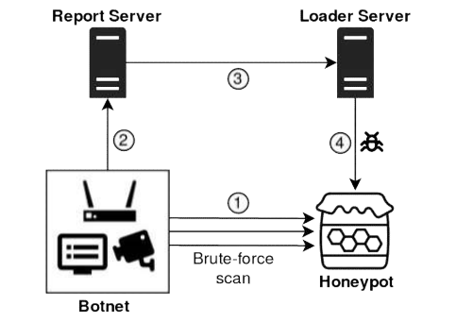
Technical Architecture
Cowrie Honeypot:
Simulates IoT devices to attract botnet traffic.
Mirai Botnet:
Targets the honeypot to infect IoT devices.
ELK Stack:
Elasticsearch for data storage and indexing.
Kibana for visualizing data in real-time.
Logstash for processing and filtering logs.

Slide 6
Data Collection and Flow
How it Works:
Mirai Botnet attacks the honeypot.
Cowries logs are captured by Filebeat and sent to Elasticsearch.
Data is analyzed and visualized through Kibana dashboards for real-time insights.
.

Slide 7
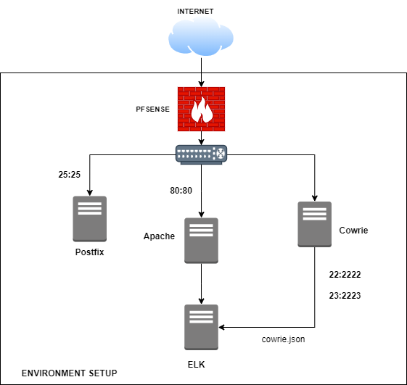
FLOW DIAGRAM

Slide 8
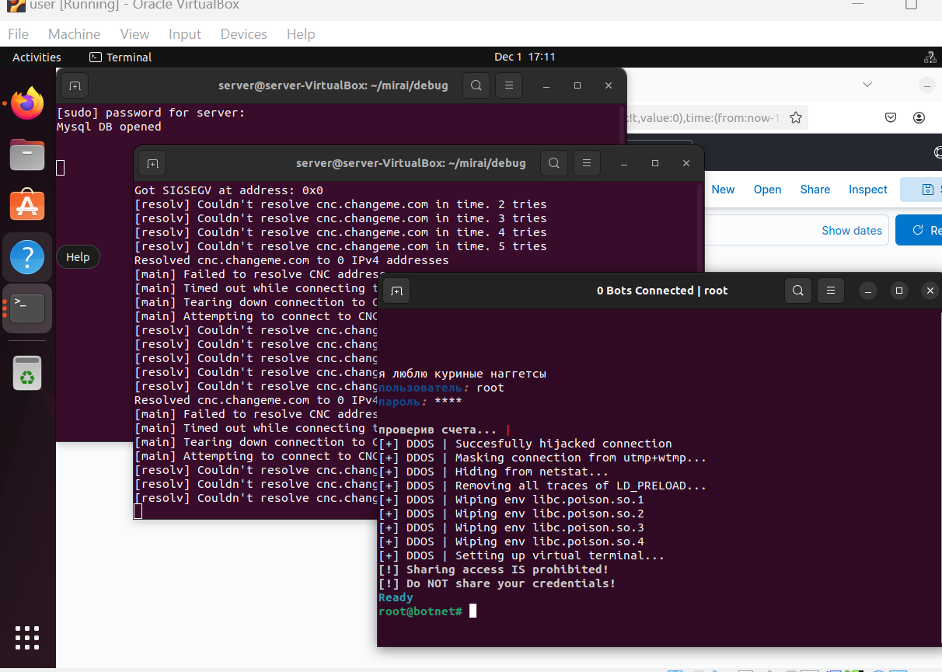
Mirai Botnet
Mirai Botnet
Run the cnc
Run a bot
connect to the cnc using telnet
see a list of attacks type
compile the release binary’s
Run the cnc

Slide 9
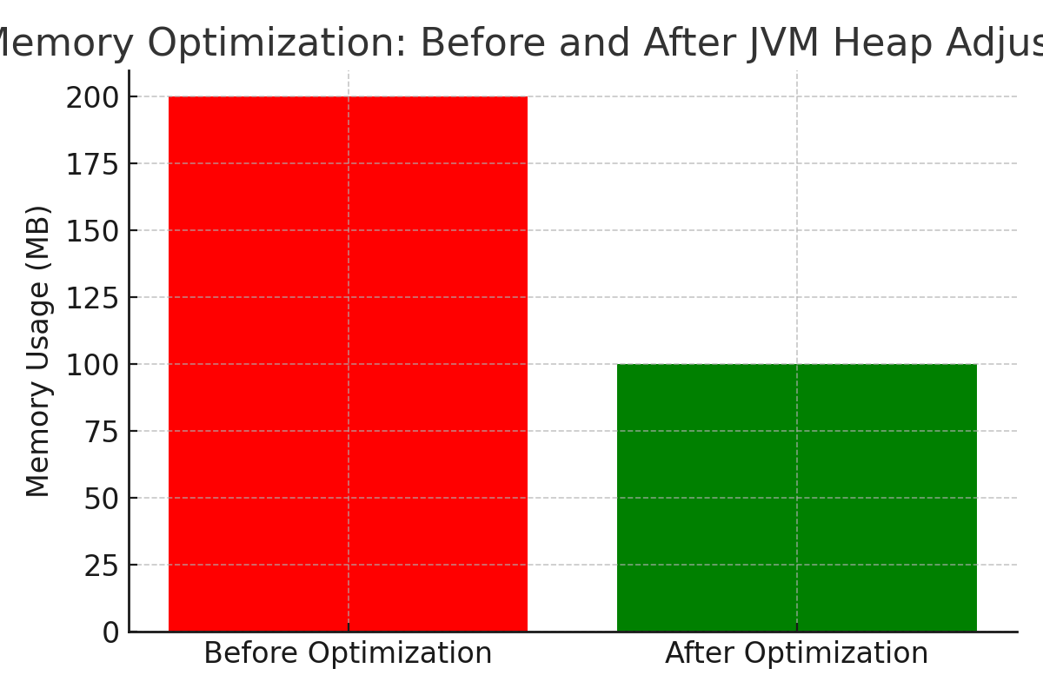
Elasticsearch Memory Optimization

Slide 10
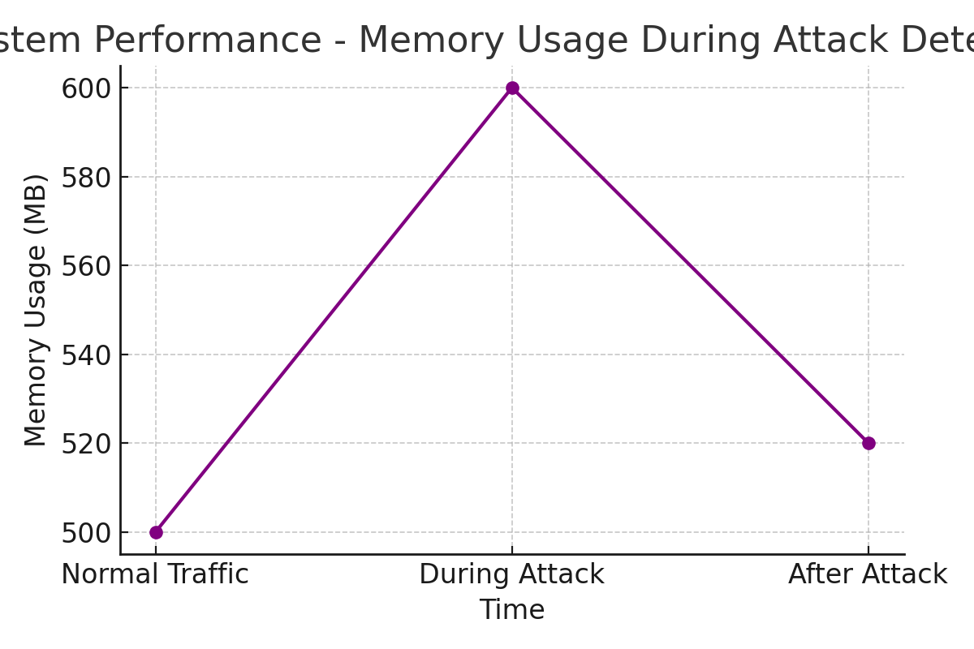
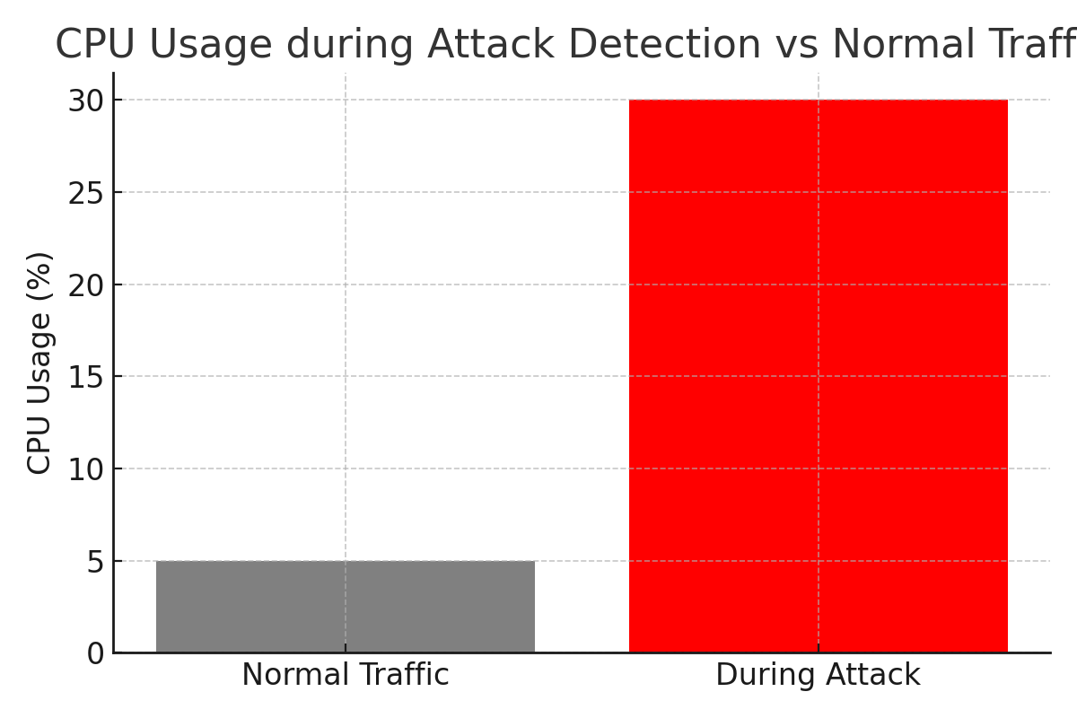
CHARTS

Slide 11
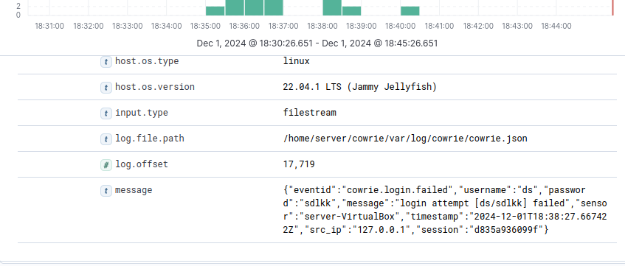
FAILED LOGIN ATTEMPT

Slide 12
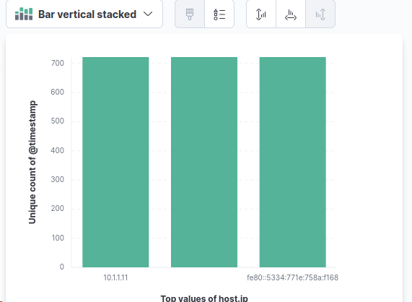
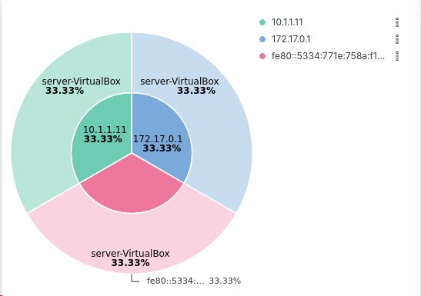
CHARTS
IP AND AGENT NAME
HOST IP

Slide 13

Evaluation Metrics
Detection Rate: Percentage of successful attack detection.
False Positive Rate: Percentage of incorrect attack alerts.
System Performance: Time taken to detect attacks, impact on system resources.

Slide 14
Detection Performance
Detection Rate:
95% detection rate for Mirai Botnet activities.
False Positive Rate: 5%.
Performance:
Real-time detection of botnet traffic.
Low CPU usage and efficient memory consumption during attack simulations.

Slide 15

CONCLUSION
The Cowrie Honeypot successfully detected Mirai Botnet in real-time.
Integration with ELK Stack enabled efficient and scalable data analysis.
High detection rate, low false positives.

